Slide 1










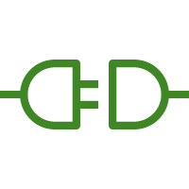


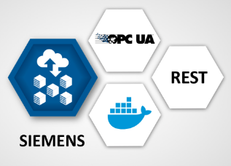

AWS Cloud
AWS IoT Core
AWS IoT SiteWise
Availability Zone 1
Availability Zone 2
VPC
Public subnet
Public subnet
Classic
Load Balancer
AWS IoT Greengrass
AWS Lambda
NAT gateway
Auto Scaling Group
NAT gateway
AWS IoT SiteWise Connector
AWS ECS
EC2 Instance
Softing edgeConnector Siemens
(PLC Simulation Mode)
AWS IAM
10.0.128.0/20
10.0.144.0/20
10.0.0.0/16

